Slide 1
Northwestern Practicum: Intro to Shrink
April 13th, 2021

Slide 2
What is shrink?
Shrink is the difference in what a company should have and what a company actually has
Home Depot shrink is the difference between the quantity of products counted at physical inventory and the store’s book inventory
Occurs at the retail dollar amount of the products
Example: If a product is $99.99 and book inventory is 10, but during the physical inventory we can only find 9. We would shrink $99.99
Home Depot’s shrink calculations is typical across industry, but other measurements could include cost of the product to the retail
Example: If a product retails for $99.99, but only cost to the retailer is $79.99, then the shrink would be $79.99

Slide 3
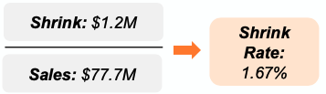
Key metrics for this project
Shrink $ (dollar): sum of all shrinking products at physical inventory
Calc: sum(retail $ of product * quantity of missing)
Swell $ (dollar): sum of all extra products at physical inventory
Calc: sum(retail $ of product * quantity of extra)
Sales: sum of all sales and returns at the end of the year
Calc: sum(total sales – total returns)
Shrink Rate: sum of all shrink $ divided by the sales, represented by a percent of sales
Calc: sum(shrink $) / sum(sales)
Example:
All shrink metrics can be aggregated from store-item(STR/SKU) level to company totals using the same formulas

Slide 4
Types of Inventories

Slide 5
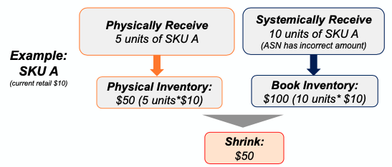
Book Inventory
Book inventory is the amount of inventory recorded in your financial statements
Maintained at the retail $ level (not in units)
Calculated at the Store/SKU level monthly
How does book inventory impact shrink?
Adding too much inventory to your book would cause shrink
Failing to reduce book inventory when product leaves the store would cause shrink (e.g., not recording a sale)

Slide 6
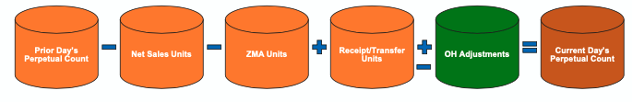
Perpetual Inventory (on-hand inventory)
What is Perpetual Inventory?
Perpetual Inventory is the operational inventory record (non-financial) of how many units are in the store of a given SKU
Perpetual Inventory has NO impact on shrink/swell results
Also called on-hand inventory or “on-hands”
How is Perpetual Inventory Calculated?
Calculated similarly to book, but movement only occurs at the unit level (e.g., price changes will not impact perpetual counts)
On-Hand adjustments allow associates to change perpetual inventory units

Slide 7
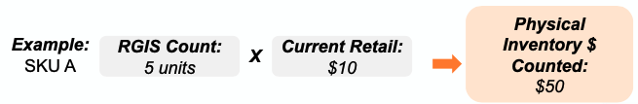
Physical Inventory
What is Physical Inventory?
▪The retail dollar amount of the physical product counted in the store ▪Maintained at the retail $ level (not in units)
How is Physical Inventory Calculated?
▪Physical inventory is the annual process to count all product in each store
▪Performed by third-party RGIS with HD Associate (Inventory Supervisor)
▪Units counted are multiplied by current retail and compared to expected Book Inventory to produce shrink amount

